Slide 1
BLACK FRIDAY
RAVI PRAKASH BAJPAI

Slide 2
INTRODUCTION
Business Problem Framing
In real world many company are dealing with sales of product so according to there features provided data can be analysed which will help in growth in sale and improvement of business.
Conceptual Background of the Domain Problem
Domain is basically understanding how to increase the sale of any business by analysing data
Motivation for the Problem Undertaken
Through this project i may able to help any business person dealing with sale of product either it is on big scale or it may be on small scale

Slide 3
DATA CLEANING AND PREPROCESSING
Data Sources and their formats
Data for this project was already provided to us by our team from flip robo. Features in the data are of both the type that is object and numeric.
Data Preprocessing Done
It can be observed from juyper notebook that there was two features with missing data or having null value, so for product_category_2 mode method has been applied to fill the null values and product_category_3 has been droped because there were nearly 70% values which were not present.
After filling the null value get dummies has been applied to convert object data type into numeric.

Slide 4
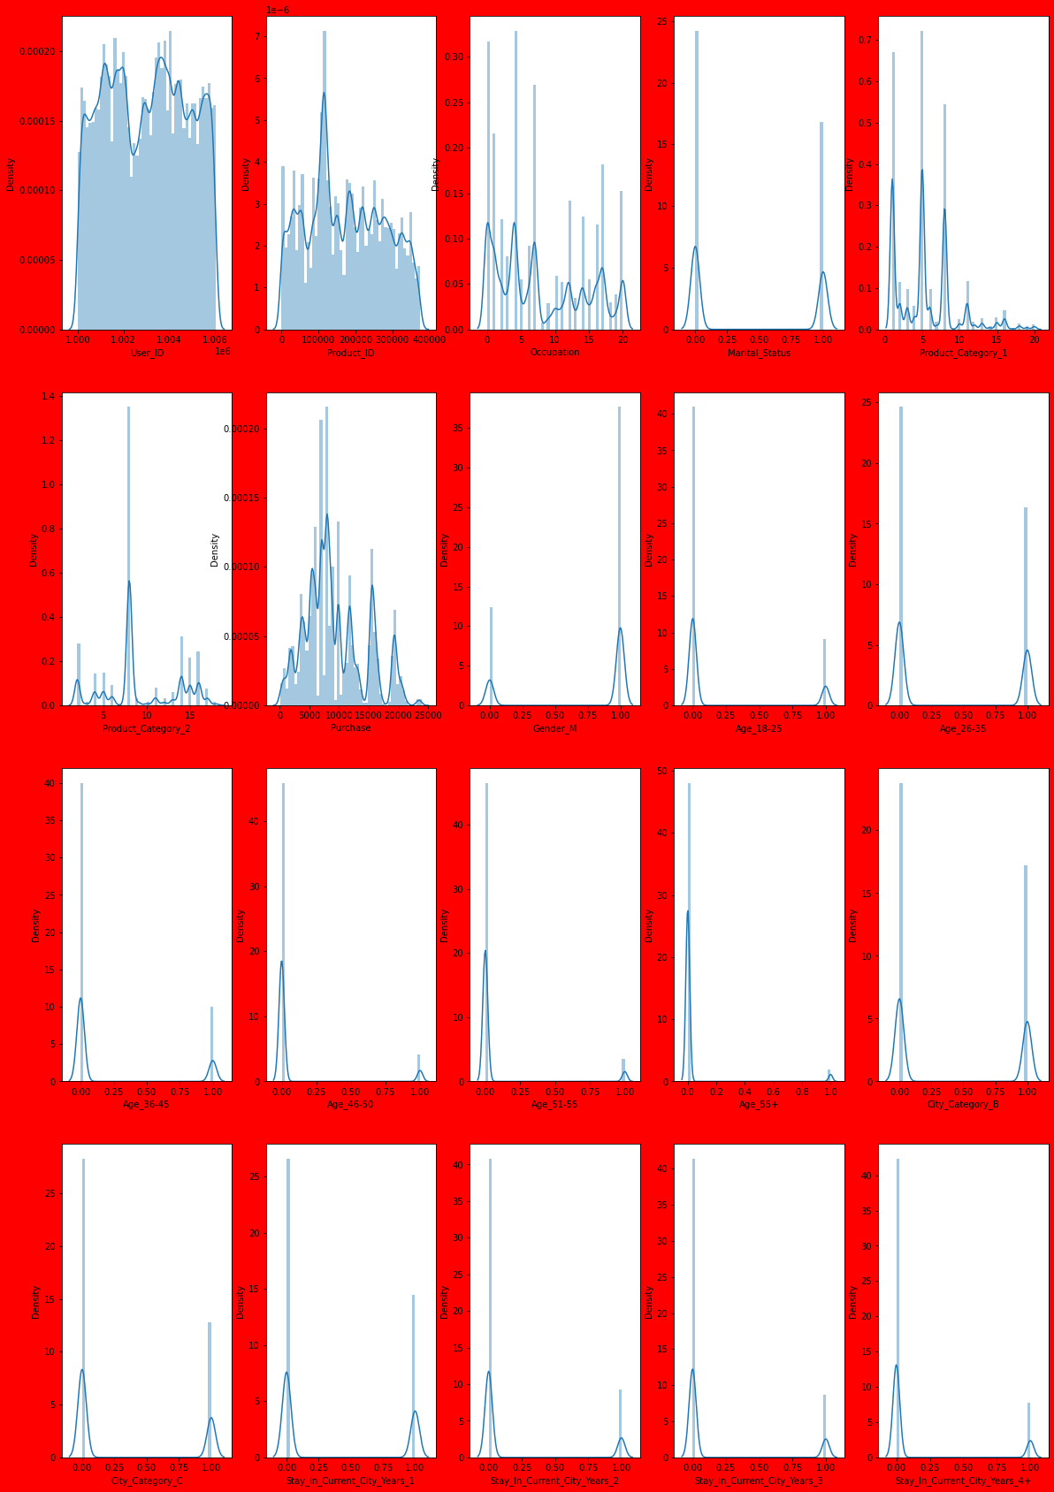
Visualizations
Displot

Slide 5
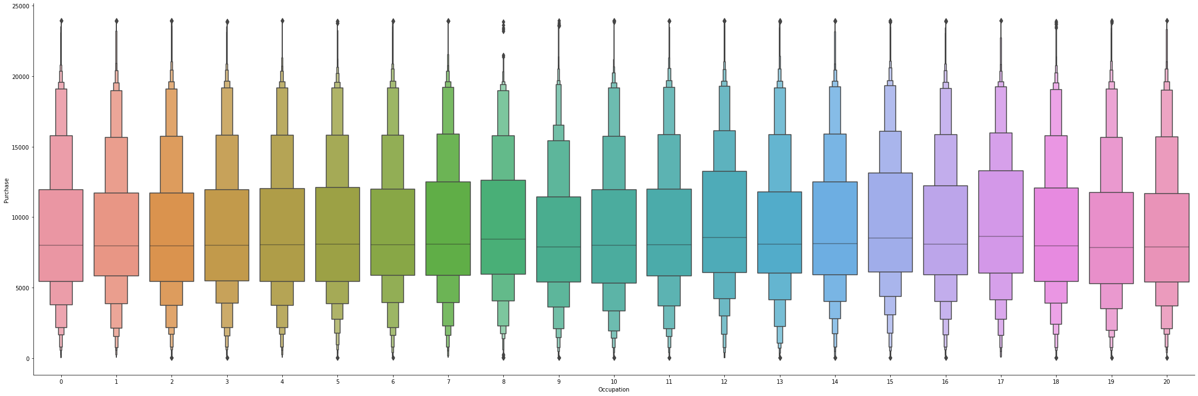
Visualizations
Catplot
Outlier can be clearly observed from the above graph it is showing maximum in 8 category.

Slide 6
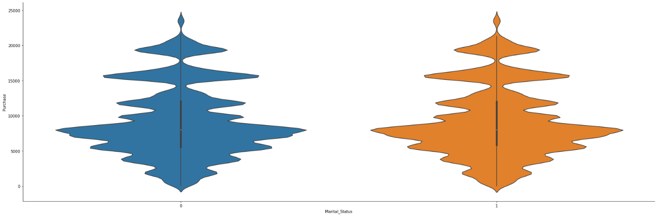
Visualizations
Catplot
From martial_status of any person effect on purchase do not vary that either 0 or 1 both are showing nearly same.

Slide 7
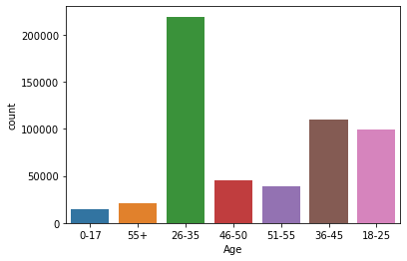
Visualizations
From count of age it can be infered that age group of 26-35 are more in count.

Slide 8
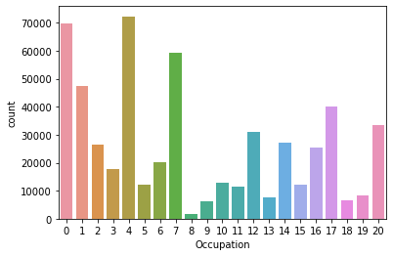
Visualizations
it can be observed that occupation type 4 has maximum number abd type 8 are least in numbers.

Slide 9
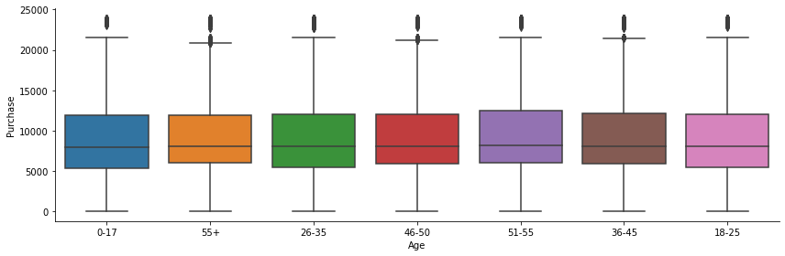
Visualizations
From above plot it can be analysed that there are many outliers present in age features.

Slide 10
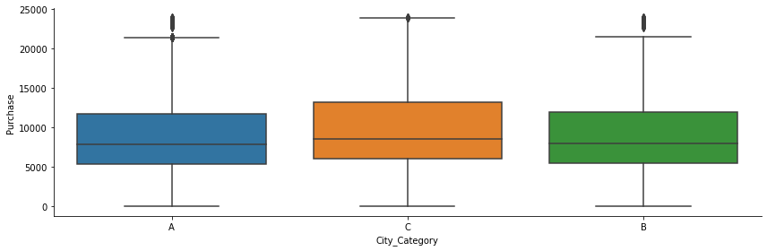
Visualizations
From above cat plot it can be seen that city category B purchase more than other two category and category A purchase is least of all three.

Slide 11
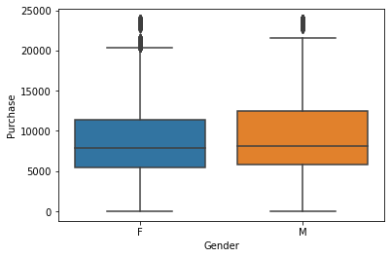
Visualizations
From above plot it can be seen that in female category of gender there are more outliers and purchase of male is more than female

Slide 12
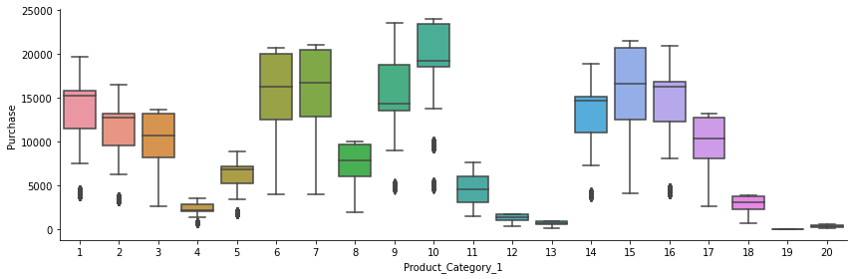
Visualizations
it can be observed from above graph that category 10 of product_category_1 is most purchased and 19 and 20 is least purchased.

Slide 13
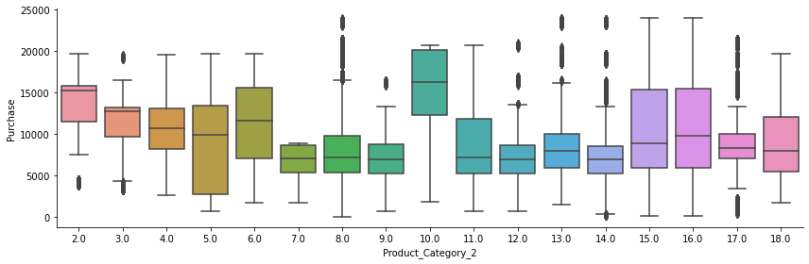
Visualizations
it can be observed from above graph that 10,15 and 16 is purchase maximum, and maximum outliers are present in 17 and 8.

Slide 14
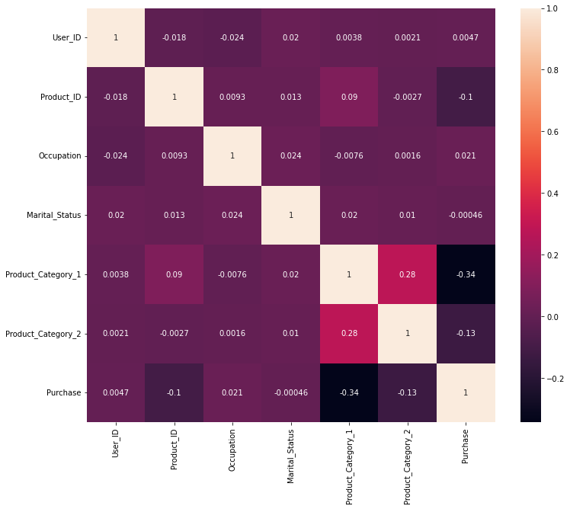
Visualizations

Slide 15
Visualizations
From heat map it can be observed that no two features are tightly corelated with each other nor they are corelated with label.

Slide 16
Visualizations results
From above visualization it can be interpreted that different features are influencing label differenly.it can also be seen that particalur categorical data is much effective than whole feature, for example in occupation count plot it can be oberved that 0,4,7,12,17,20 are covering most of the count so seller can focus on these these of people have above occupation type

Slide 17
Conclusion
In this project it can be concluded that how particular area in ploted graph or we can say particular categorical data of features can be more effective than the whole features. This project gives idea that in which area of any given feature seller should concentrate more to increase the purchase and attract the purchaser by giving offer to such customer.

